Slide 1

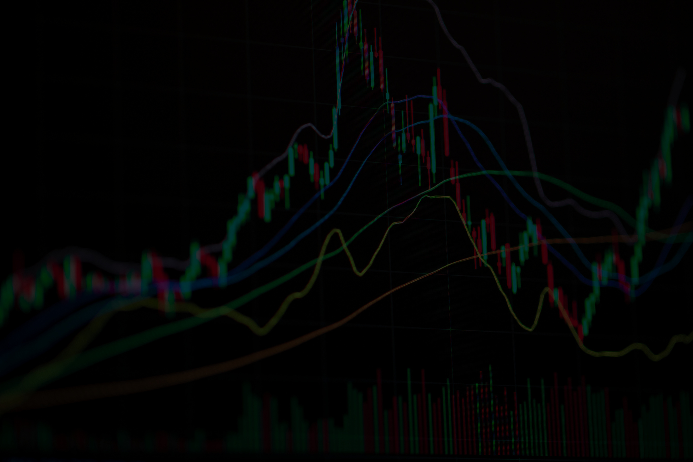

BITCOIN PRICE TREND ANALYSIS
Karthik Peddavarapu

Slide 2
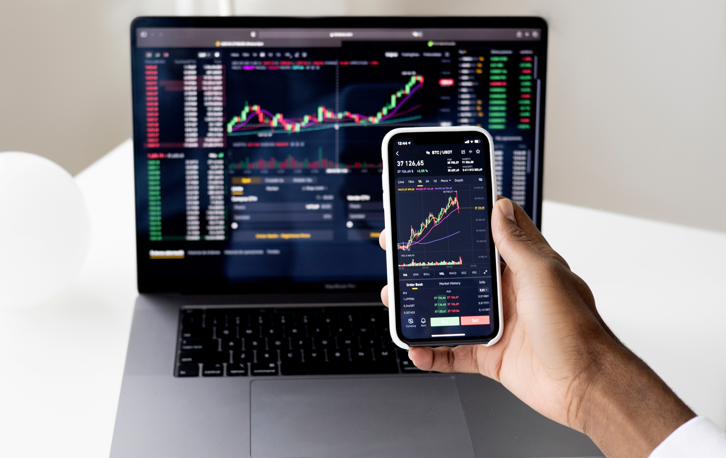

Problem Statement
The objective of this project is to analyze historical Bitcoin price data to uncover trends, patterns, and anomalies in Bitcoin’s daily trading performance from 2018 to 2025. By leveraging Python’s data analysis and visualization libraries, the project aims to answer key questions

Slide 3
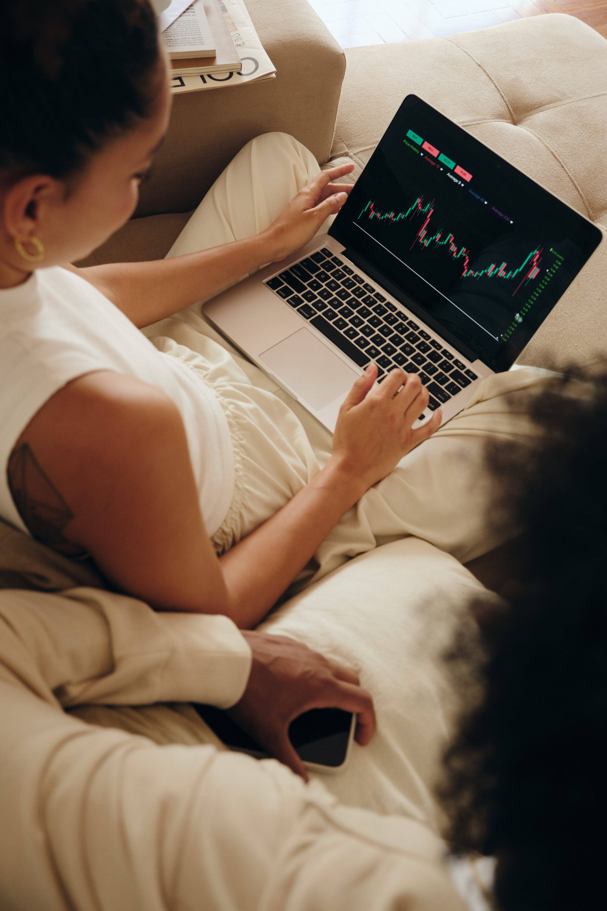
DATASET OVERVIEW
Timeframe: January 2018 to April 2025
Source: Kaggle
Open time: The timestamp for when the interval began.
Open: The price of Bitcoin at the beginning of the interval.
High: The highest price during the interval.
Low: The lowest price during the interval.
Close: The price of Bitcoin at the end of the interval.
Volume: The trading volume during the interval.
Close time: The timestamp for when the interval closed.
Quote asset volume: The total quote asset volume traded during the interval.
Number of trades: The number of trades executed within the interval.
Taker buy base asset volume: The volume of the base asset bought by takers.
Taker buy quote asset volume: The volume of the quote asset spent by takers.

Slide 4
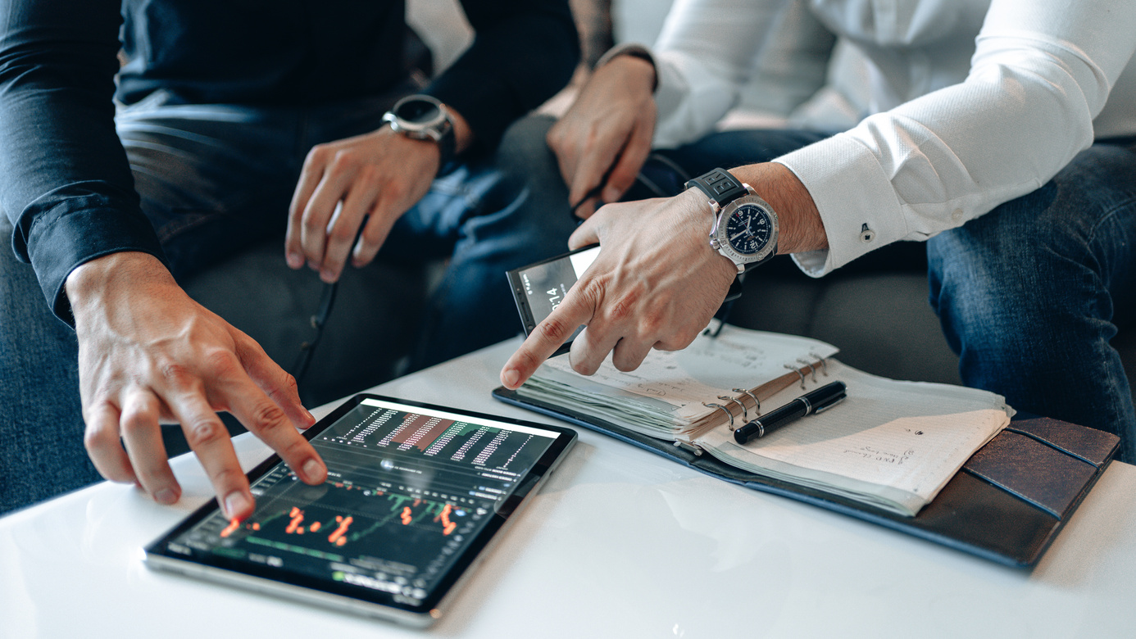
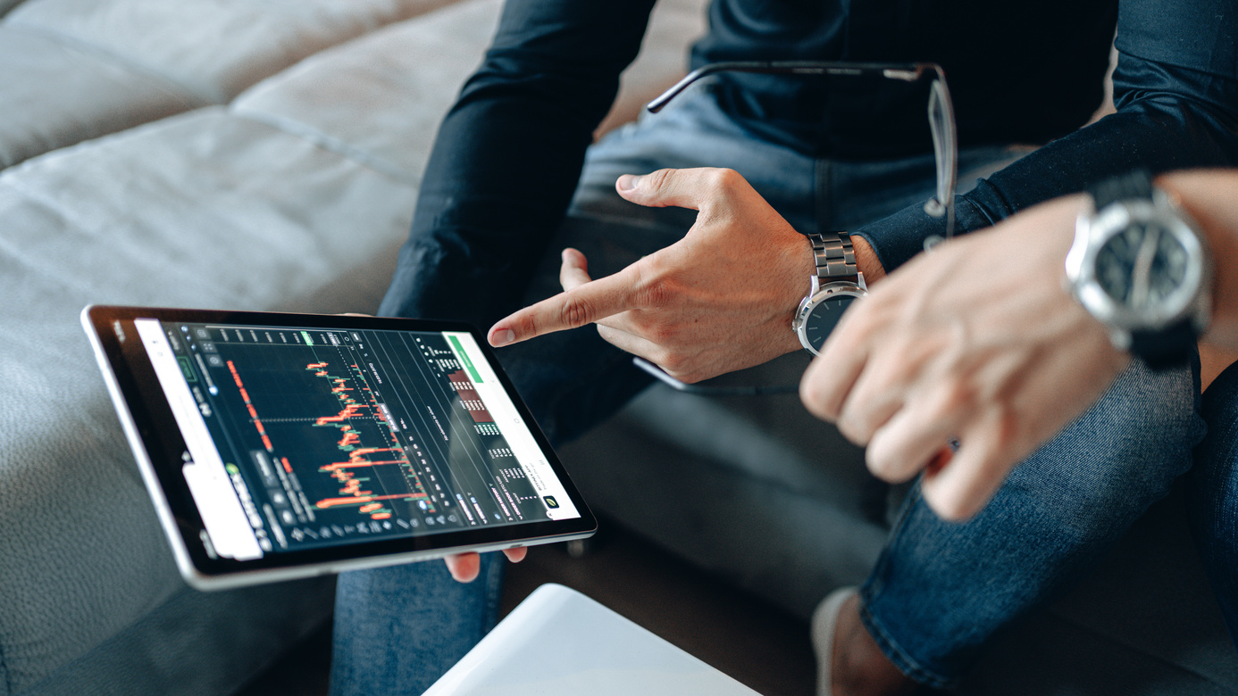

Tools and Technologies
Python
Pandas
NumPy
Matplotlib
Seaborn
Jupyter Notebook

Slide 5


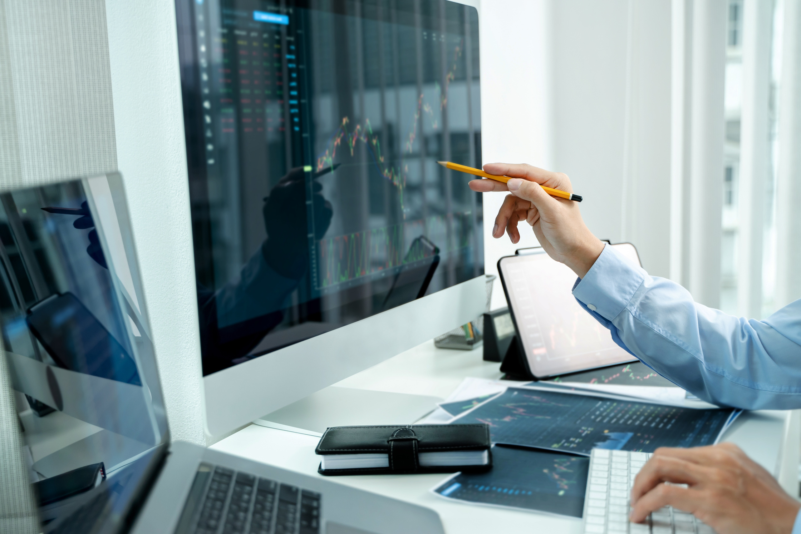
Data Cleaning
Checked for missing values and duplicates
Converted date columns to datetime format
Sampled rows for clearer visualizations

Slide 6
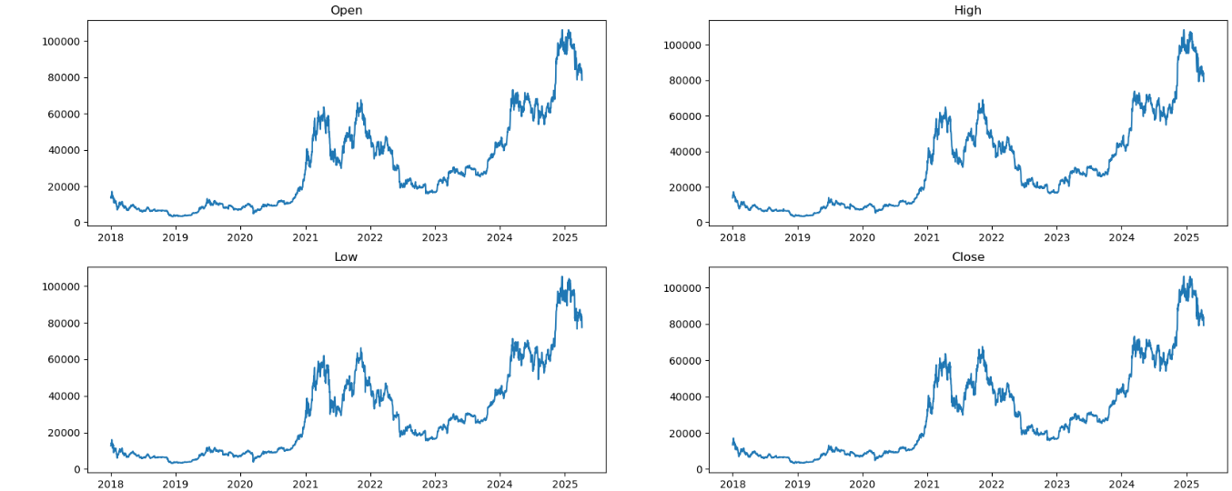
Change in price of bitcoin overtime
Bitcoin Price Growth After 2020
Market Decline in 2022–2023

Slide 7
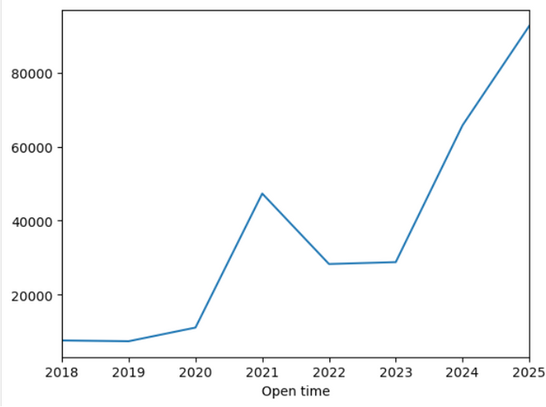
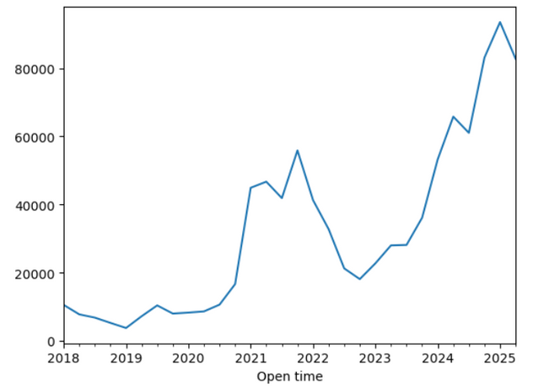
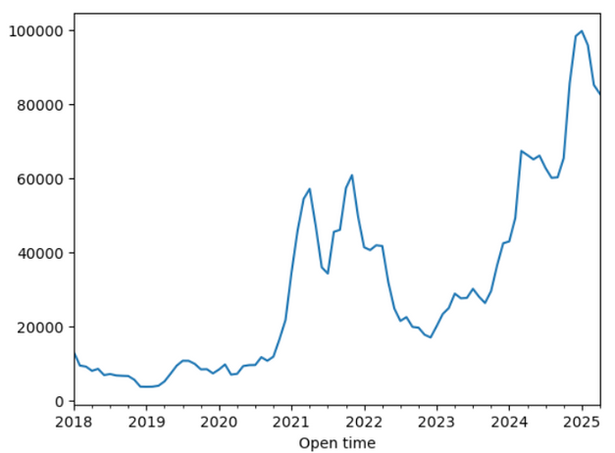
Opening price Trend on Yearly, Quarterly, Monthly
Yearly Trend
Quarterly Trend
Monthly Trend

Slide 8
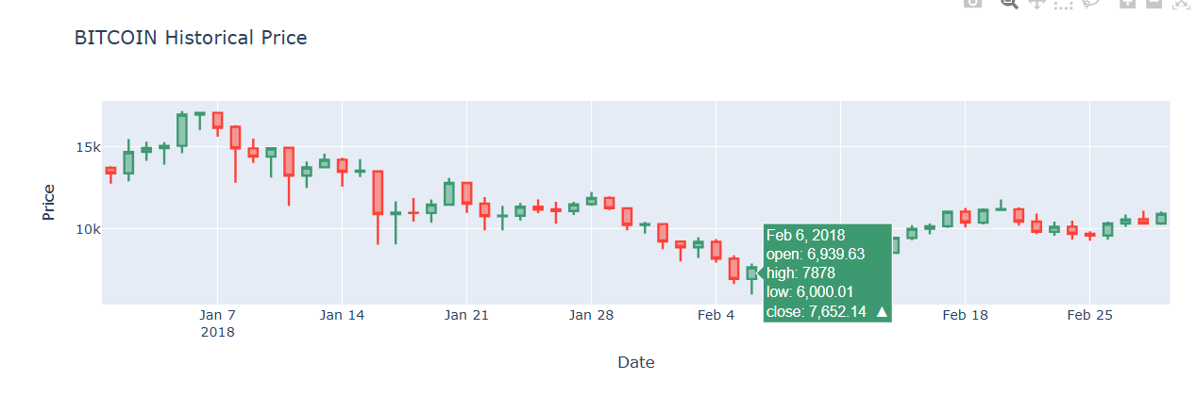
Bitcoin Price using Candlestick Chart

Slide 9
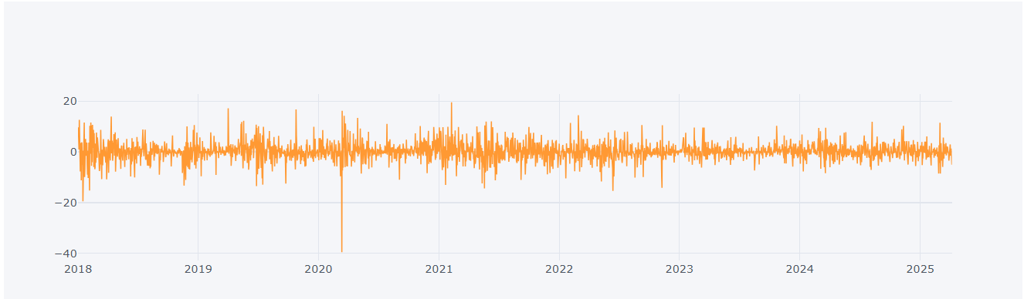
Daily change in Closing price of stock

Slide 10
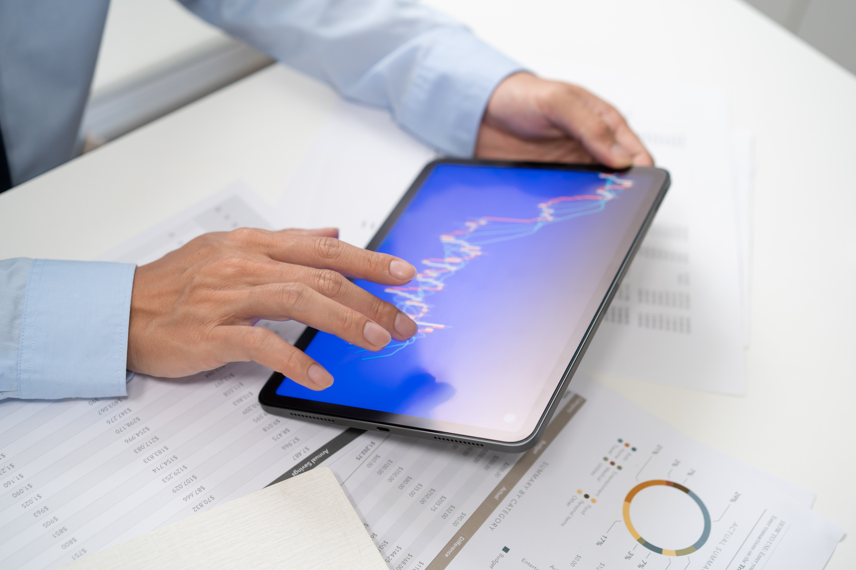


Conclusion
Bitcoin Price Growth After 2020
Price peaked near $69,000 in November 2021.
Driven by institutional adoption and pandemic-related demand.
Market Decline in 2022–2023
Price corrected to $20,000 - $30,000 range in 2023.
Factors: inflation concerns, rate hikes, and regulatory pressures.
Present Market Trend
Price stabilization after 2022 crash.
Continued volatility and cautious investor sentiment.

Slide 11
THANK
YOU.

